Slide 1
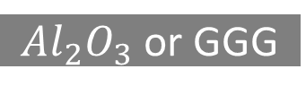
Cr/Au
Ru
Ta
Cr/Au
CoFeB
Ru
MgO
Ta
CoFeB
CoFeB
CoFeB
$Al_{2}O_{3}$ or GGG
MgO
MgO
FeGa
FeGa
FeGa
FeGa
PMN-PT
PMN-PT
PMN-PT
PMN-PT
PMN-PT
Kapton
Kapton
Kapton
Kapton
Kapton
Thin-film 1
Thin-film 2
Thin-film 3
Thin-film 4
Thin-film 5

Slide 2
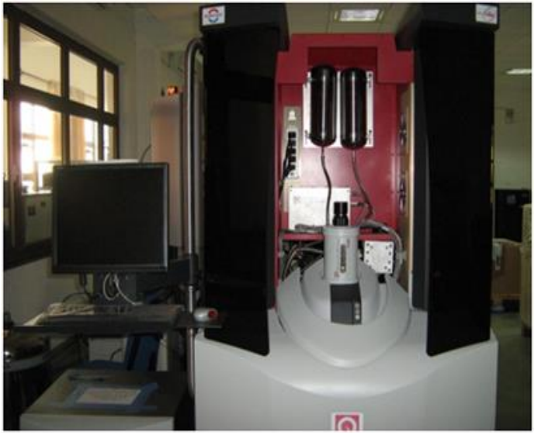
VSM (Vibrating Sample Magnetometer)
H field
Pick up coil
Sample position
transformer
SQUID with electronics
M Mohanlal Naik
IISER Bhopal
47

Slide 3
Laser source
Photo detector
Flexible cantilever
Magnetic tip
Sample

